Slide 1
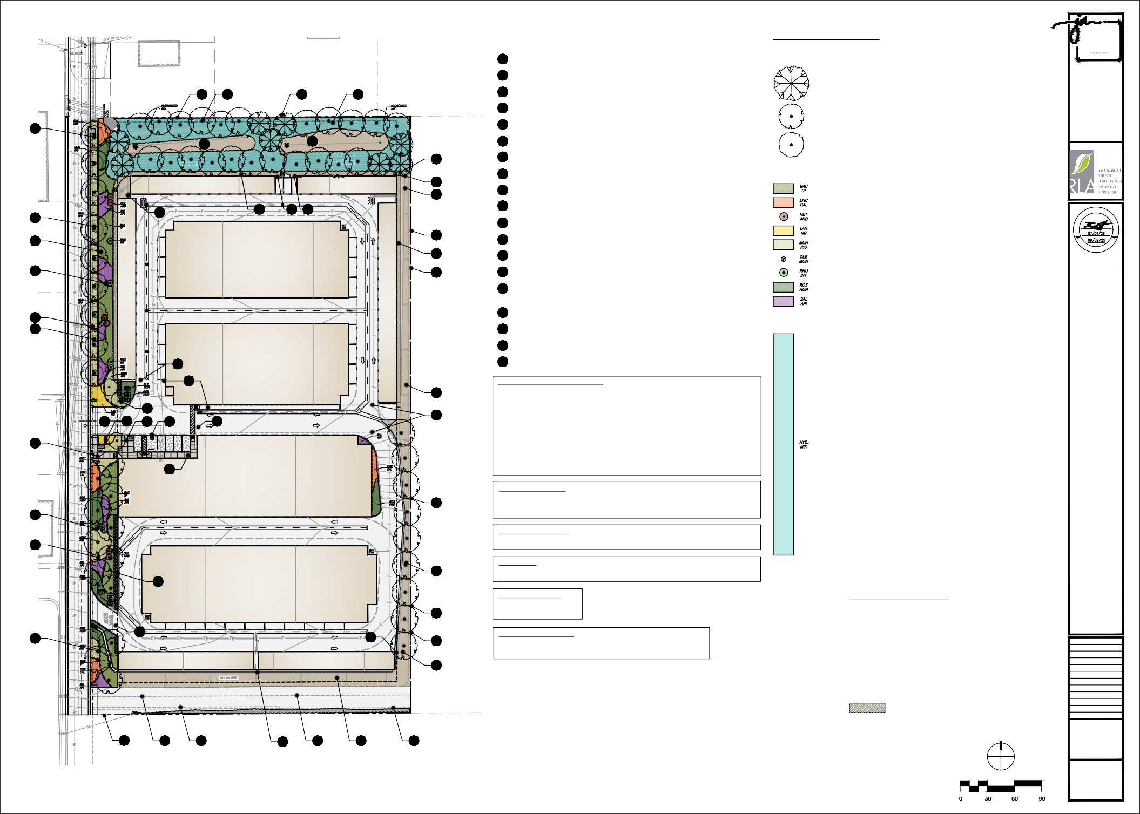
LEGEND
PROPOSED PLANT SCHEDULE
TREES
SYMBOL BOTANICAL NAME
JORDA N
A R C H I T E C T S
131 CALLE IGLESIA, SUITE 100 SAN CLEMENTE, CA 92672
1
PROPERTY LINE
COMMON NAME
SIZE / FORM
HT. X SPRD. X CAL. (MIN.)
WATER USE
DESCRIPTION
RESIDENTIAL PROPERTIES
2
DRIVEWAY EXIT / ENTRANCE
PLATANUS RACEMOSA
WESTERN SYCAMORE
24" BOX STD.
10'H X 5'W X 1-1/4" CAL.
L
NATIVE SCREENING / BASIN TREE
1
6
18
3
3 DROUGHT TOLLERANT PLANTING
4
RETENTION BASIN WITH CRUSHED ROCK BASE
QUERCUS AGRIFOLIA
COAST LIVE OAK
24" BOX STD.
10'H X 4'W X 1-1/4" CAL.
VL
NATIVE CANOPY TREE
13
X
5
ACCENT TREE
4
4
X
6 SCREENING TREE
LAGERSTROEMIA INDICA X FAURIEI 'MUSKOGEE'
MUSKOGEE CRAPE MYRTLE
24" BOX STD.
11'H X 5'W X 1-1/4" CAL.
M
STREET TREE
X
16
7
NATURAL GRAY CONCRETE WALKWAY
SHRUBS, VINES & GROUNDCOVERS
SYMBOL KEY BOTANICAL NAME
PROPOSED STORAGE FACILITY
PROPOSED STORAGE FACILITY
17
14
8
DECOMPOSED GRANITE PAVING
COMMON NAME
SIZE
SPACING
WATER USE
DESCRIPTION
X
9 EXISTING CHAIN-LINK FENCE
BACCHARIS P. 'TWIN PEAKS'
DWARF COYOTE BUSH
1 GAL.
48" O.C.
L
NATIVE MEDIUM HEIGHT MOUNDING SHRUB
ORNAMENTAL GRASS
NATIVE EVERGREEN HEDGE
17
8
17 16
X
10
ELECTRICAL UTILITY EASEMENT
ENCELIA CALIFORNICA
CALIFORNIA BRITTLEBUSH
5 GAL.
30" O.C.
L
A
N
D
S
C
A
P
13
HETEROMELES ARBUTIFOLIA
TOYON
15 GAL.
72" O.C.
L
D
L
B
E
A
E
B
E
R
R
11 ROAD UTILITY EASEMENT
E
S
T
L
C
S
I
A
H
N
V
4
I
E
A
6
T
X
R
2
E
FLOWERING LOW SHRUB
C
T
4
C
LANTANA 'NEW GOLD'
NEW GOLD LANTANA
5 GAL.
36" O.C.
L
I
Signature
T
3
1
12 ADA PARKING STALLS
ORNAMENTAL GRASS
L
S
Renewal Date
A
T
I
X
MUHLENBERGIA RIGENS
DEER GRASS
1 GAL.
36" O.C.
L
A
Date
N
T
R
E
O
C
F
O
I
L
PROPOSED STORAGE FACILITY
PROPOSED STORAGE FACILITY
PROPOSED STORAGE FACILITY
X
8
13 BMP TREE WELL
OLEA MONTRA
LITTLE OLLIE
5 GAL.
42" O.C.
L
EVERGREEN HEDGE
NATIVE EVERGREEN HEDGE
EVERGREEN GROUNDCOVER
NATIVE FLOWERING SHRUB
F
A
3
X
SDG&E BATTERY STORAGE FACILITY
9
14 ORGANIC MULCH
RHUS INTEGRIFOLIA
LAUREL SUMAC
15 GAL.
48" O.C.
L
15 BLACK DECORATIVE TUBE STEEL AUTOMATIC VEHICULAR GATE WITH FIRE DEPT. KNOX SWITCH AND OPTICOM ACCESS AS REQIURED.
ROSMARINUS OFFICINALIS 'HUNTINGTON CARPET'
HUNTINGTON CARPET ROSEMARY
1 GAL.
48" O.C.
L
1
13
X
16
BLACK TUBE STEEL PEDESTRIAN GATE
SALVIA APIANA 'COMPACTA'
WHITE SAGE
1 GAL.
36" O.C.
VL
X
17
8' HIGH BLACK TUBE STEEL FENCE
HYDROSEED MIX (.35 ACRES)
SYMBOL KEY BOTANICAL NAME
COMMON NAME
LBS/ ACRE
EXISTING ACCESS ROAD
X
18 BIKE RACKS
AMBROSIA PSILOSTACHYA
WESTERN RAGWEED
3
15
PROPOSED STORAGE FACILITY
X
19
DECORATIVE MONUMENT SIGN
ANEMOPSIS CALIFORNICA
YERBA MANSA
2
16
X
CROTON SETIGER
DOVEWEED
0.5
14
CONCEPTUAL IRRIGATION DESIGN STATEMENT:
PLEASE NOTE THE FOLLOWING PRINCIPLES OF DESIGN UTILIZED ON THIS PROJECT DIRECTED SPECIFICALLY AS CONSERVING WATER AND IMPROVING THE EFFICIENCY OF THE IRRIGATION SYSTEM:
DIPLACHUS AURANTIACUS
BUSH MONKEYFLOWER
2
5
18
X
IRRIGATION DESIGN UTILIZING DRIP IRRIGATION WITH 90% EFFICIENCY AND UP TO 40% REDUCTION IN WATER USAGE. ALL HEAD SPACED HEAD TO HEAD 100% OF MANUFACTURERS RECOMMENDED RADIUS.
ALL SPRINKLER HEADS UTILIZE MATCHED PRECIPITATION NOZZLES AND CHECK VALVES. ALL SPRINKLER HEADS UTILIZE PRESSURE COMPENSATING SCREENS.
TRIANGULAR SPACING UTILIZED FOR HEAD LAYOUT THROUGHOUT IRRIGATION SYSTEM.
IRRIGATION ZONES SEPARATED BY PLANT MATERIAL TYPES. IRRIGATION ZONES SEPARATED BY EXPOSURE AND ORIENTATION. UTILIZATION OF IRRIGATION SYSTEM MASTER VALVE.
UTILIZATION OF IRRIGATION SYSTEM FLOW SENSOR.
UTILIZATION OF RAIN SHUT-OFF DEVICE CONNECTED TO IRRIGATION CONTROLLER. UTILIZATION OF CONTROLLER WITH WATER BUDGETING FEATURE.
ENCELIA CALIFORNICA
CALIFORNIA ENCELIA
2
2
19
12
15
X
11
ERIOPHYLLUUM CONFERTIFLORUM
GOLDEN YARROW | 1
SMALL FESCUE | 8
GRACEFUL TARPLANT | 0.5
FESTUCA MICROSTACHYS
17
X
HOLOCARPHUS VIRGATA 'ELONGATA'
FALLBROOK SELF STORAGE
1305 E. MISSION ROAD FALLBROOK, CA 92028
7
X
IRRIGATION SYSTEM SHALL BE TESTED AND MAINTAINED ON A MONTHLY BASIS BY THE MAINTENANCE STAFF. AN IRRIGATION AUDIT, IN COMPLIANCE WITH THE STATE OF CALIFORNIA LANDSCAPE WATER MANAGEMENT PROGRAM, SHALL BE PERFORMED BY A CERTIFIED IRRIGATION AUDITOR PRIOR TO TURNOVER OF PROJECT AND EVERY 5 YEARS THEREAFTER. THE REGULAR MAINTENANCE SCHEDULE COUPLED WITH THE AUDITS SHOULD HELP TO MAINTAIN THE IRRIGATION EFFICIENCY AS INTENDED IN THE DESIGN
LASTHENIA CALIFORNICA | GOLDFIELDS | 1
LUPINUS BICOLOR | MINATURE LUPINE | 4
MUHLENBERGIA RIGENS | DEERGRASS | 0.5
OENOTHERA ELATA 'HOOKERI' | EVENING PRIMROSE | 1
PLANTAGO ERECTA | PLANTAIN | 6
SISYRINCHIUM BELLUM | BLUE-EYED GRASS | 2
STIPA CERNUA | NODDING NEEDLEGRASS | 6
STIPA PULCHRA | PURPLE NEEDLEGRASS | 6
PROPOSED STORAGE FACILITY
X
STATEMENT OF COMPLIANCE:
X
9
“THIS LANDSCAPE DESIGN AND THE FINAL LANDSCAPE PLANS WILL REFLECT CONFORMANCE WITH THE COUNTY OF SAN DIEGO’S WATER CONSERVATION IN LANDSCAPING ORDINANCE, PROMOTING WATER CONSERVATION THROUGH THE USE OF MODERATE AND LOW-WATER REQUIRING PLANT SPECIES, GROUPING OF PLANT MATERIALS WITH SIMILAR WATER REQUIREMENTS AND IMPLEMENTING A LOW VOLUME AND EFFICIENT AUTOMATIC IRRIGATION SYSTEM.”
6
X
X
MAINTENANCE RESPONSIBILITY
3
X
A. ALL LANDSCAPE AND IRRIGATION TO BE MAINTAINED BY PROPERTY OWNER.
X
14
PROJECT NOTES
WATER USE KEY:
VL = VERY LOW WATER USE, L = LOW WATER USE, M = MODERATE WATER USE, H = HIGH WATER USE. WATER USE STATED IS PER 'WATER USE CLASSIFICATION OF LANDSCAPE SPECIES' (ALSO REFERRED TO AS WUCOLS IV) FOR THE CITY OF FALLBROOK.
17
PROPOSED STORAGE FACILITY
X
ANY SIGNAGE SHALL BE SUBMITTED UNDER A SEPARATE APPLICATION AND PERMIT PROCESS.
NO HAZARDOUS MATERIALS TO BE STORED ON SITE.
X
LANDSCAPE CALCULATIONS
TOTAL SITE AREA: 232,122 SF.
TOTAL LANDSCAPE AREA: 48,192 SF.
PERCENT LANDSCAPE AREA: 21%
EXISTING PLANT SCHEDULE
TREES
SYMBOL BOTANICAL NAME
X
1
COMMON NAME
COMMENTS
3
15
16
9
TREE MITIGATION CALCULATIONS
QUERCUS AGRIFLIA
COAST LIVE OAK
PROTECT IN PLACE
Date: 09-02-25
Project: FALLBROOK SELF STORAGE
File:
PROPOSED STORAGE FACILITY
X
TOTAL 8" CAL OR GREATER OAK TREES REMOVED: 18
REQUIRED OAK TREE MITIGATION (1) OAK REMOVED = (3) 24" BOX OAKS PROPOSED) = 51 REQUIRED OAKS
TOTAL PROVIDED 24" BOX OAK TREES: 51
PROPOSED STORAGE FACILITY
X
17
WASHINGTONIA ROBUSTA
MEXICAN FAN PALM
PROTECT IN PLACE
Revisions:
X
SHRUBS, GRASSES, & GROUNDCOVERS
SYMBOL DESCRIPTION
COMMENTS
EXISTING SHRUBS AND GROUNDCOVER
PROTECT IN PLACE
NOTE: THE LETTER (E) NEXT TO A TREE SYMBOL INDICATES AN EXISTING TREE TO BE PROTECTED IN PLACE. THE LETTER (R) INDICATES AN EXISTING TREE TO BE REMOVED FROM SITE.
Sheet Title:
PRELIMINARY
LANDSCAPE PLAN
1
11
10
16
11
14
10
Sheet Number:
L1.1

Slide 2
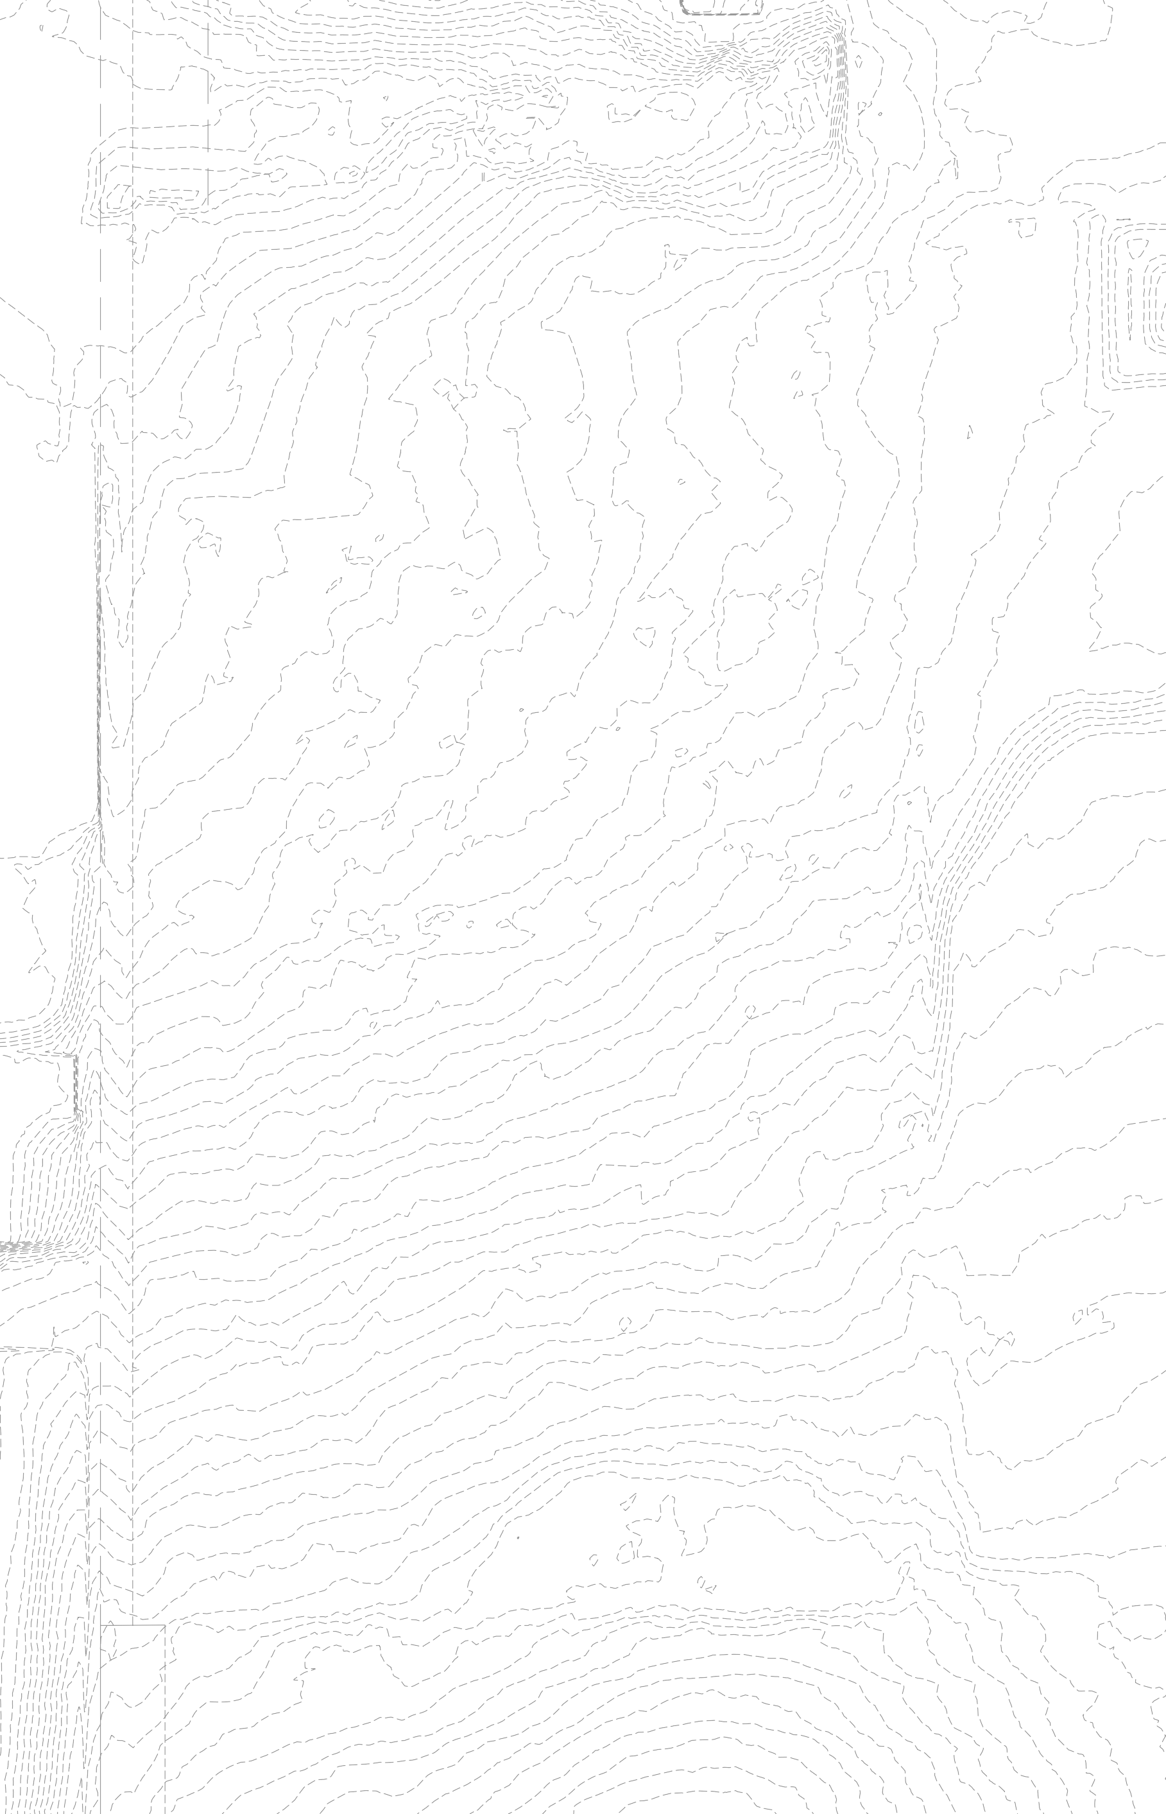
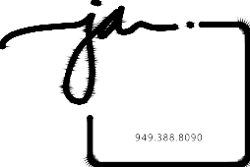
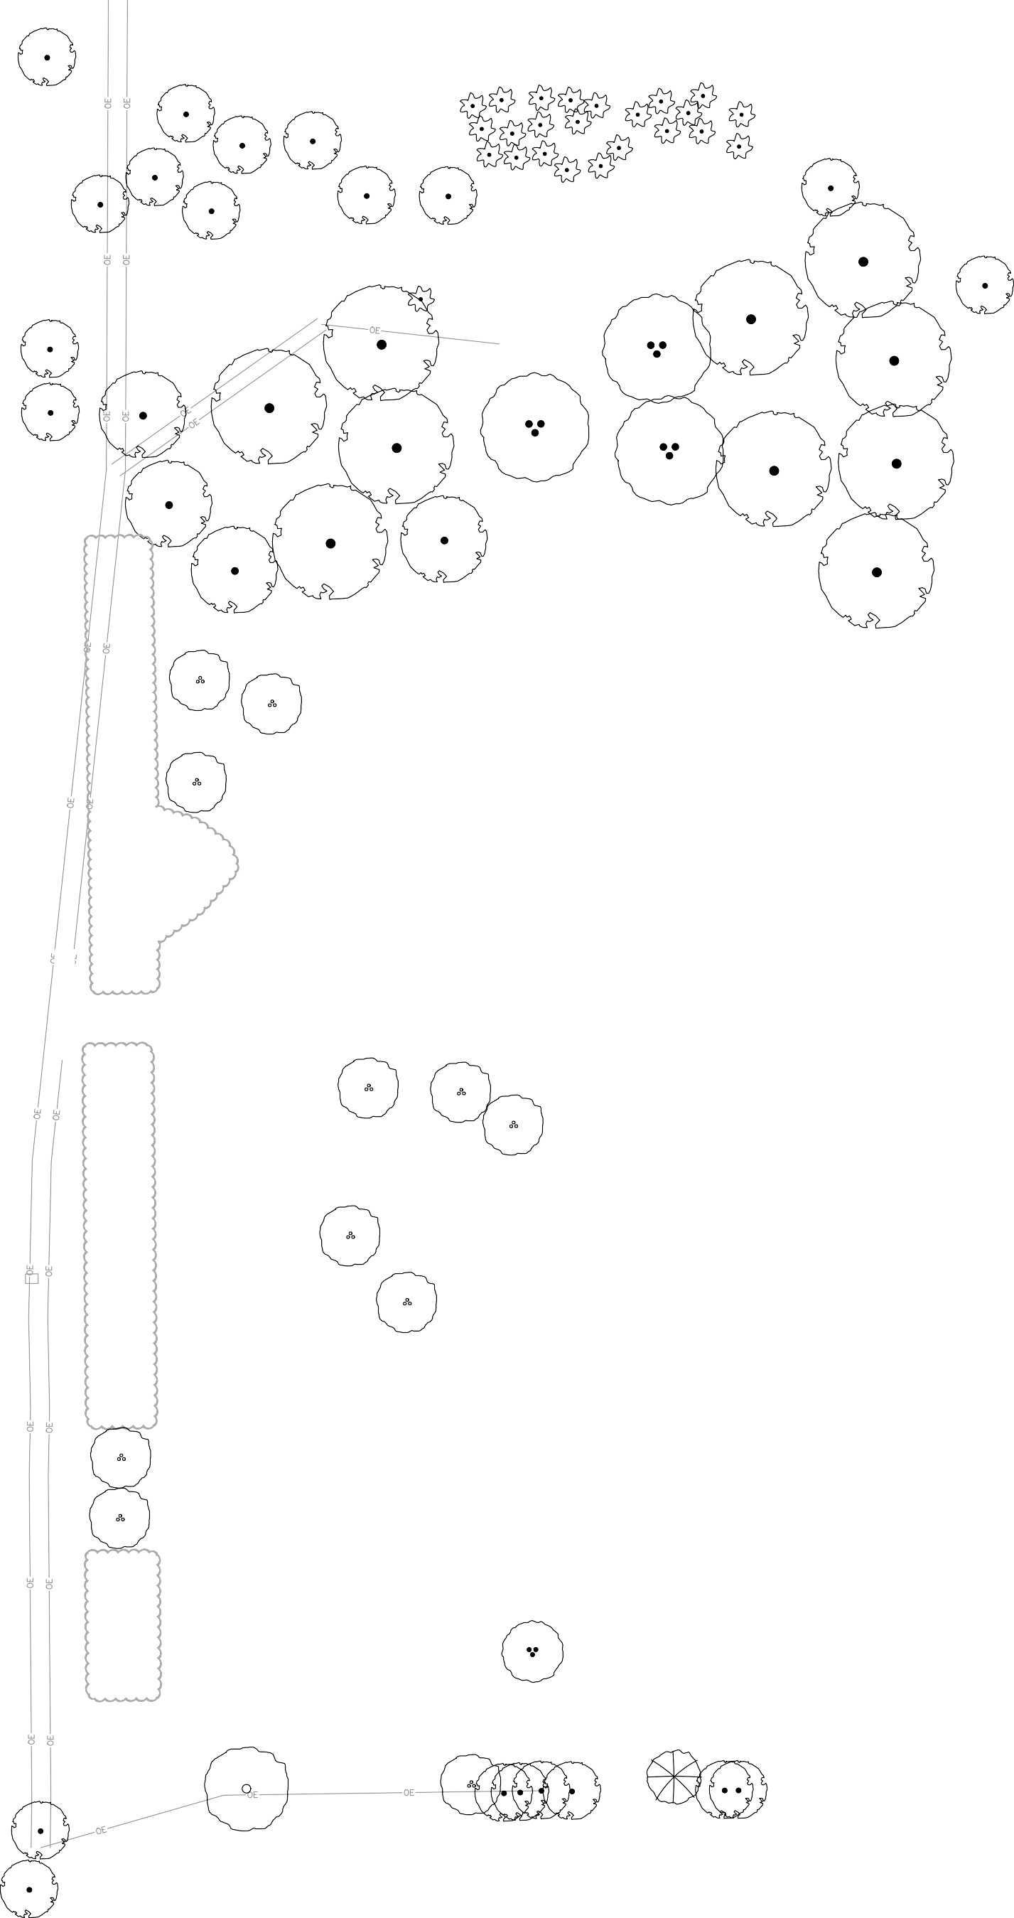
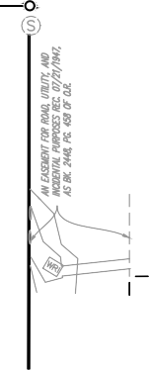

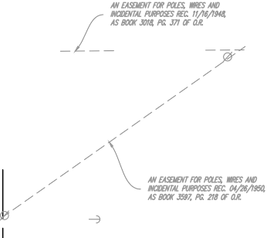




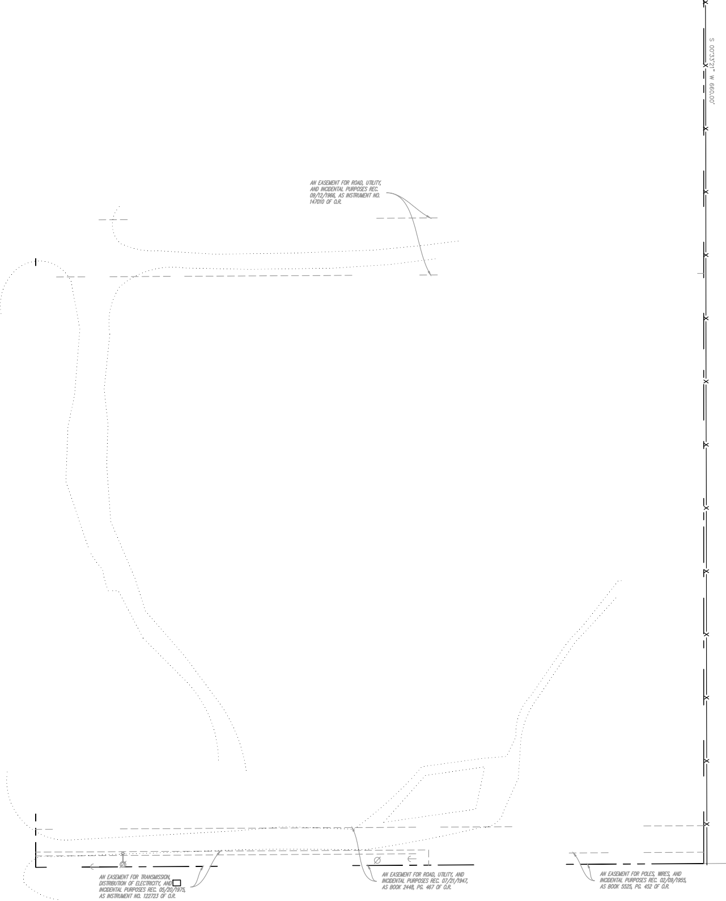

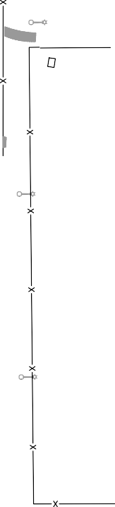
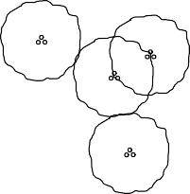


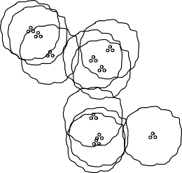
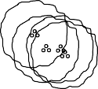
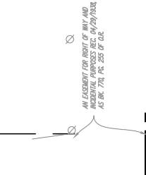
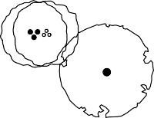
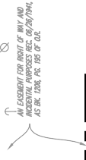
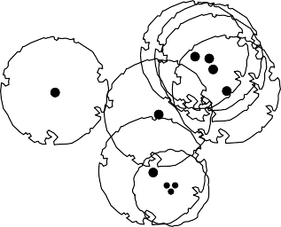


EXISTING PLANT SCHEDULE
TREES
SYMBOL | BOTANICAL NAME | COMMON NAME | COMMENTS
 | EUCALYPTUS SPP. | GUM TREE | TO BE REMOVED
 | JACARANDA MIMOSIFOLIA | BLUE JACARANDA | TO BE REMOVED
 | OLEA EUROPAEA | OLIVE TREE | TO BE REMOVED
 | QUERCUS AGRIFOLIA | CALIFORNIA LIVE OAK | --
 | SCHINUS MOLLE | CALIFORNIA PEPPER TREE | TO BE REMOVED
 | WASHINGTONIA ROBUSTA | MEXICAN FAN PALM | --
SHRUBS, GRASSES, & GROUNDCOVERS
SYMBOL | DESCRIPTION |  | COMMENTS
 | EXISTING OLIVE HEDGE |  | TO BE REMOVED
NOTE: THE LETTER (E) NEXT TO A TREE SYMBOL INDICATES AN EXISTING TREE TO BE PROTECTED IN PLACE. THE LETTER (R) INDICATES AN EXISTING TREE TO BE REMOVED FROM SITE.
JORDA N
A R C H I T E C T S
131 CALLE IGLESIA, SUITE 100 SAN CLEMENTE, CA 92672
(E)
(E)
(E)
(E)
(E)
(E)
(E)
(E)
(E)
(E)
(E)
(E)
(E)
(E)
(E)
(E)
(E)
(E)
(E)
(E)
(E)
(E)
(E)
(E)
(E)
(E)
(E)
(R)
(E)
(E)
(E)
(E)
(R)
(R)
12" CAL
(R)
14" CAL.
(R)
(R)
14" CAL.
(R)
(E)
(E)
(R)
10" CAL.
(R)
(E)
(R)
12" CAL
(E)
(R)
10" CAL.
(R)
16" CAL.
(R)
14" CAL.
(R)
(E)
A
N
D
S
C
A
P
(E)
D
L
B
E
A
(R)
E
B
E
R
R
(R)
14" CAL.
E
S
T
L
C
S
I
A
H
N
V
4
I
(R)
14" CAL.
E
A
6
T
R
2
E
C
T
4
C
I
Signature
Renewal Date
T
(R)
10" CAL.
L
S
A
T
I
A
Date
N
T
R
E
O
C
F
O
I
L
(R)
(R)
12" CAL
SDG&E BATTERY STORAGE FACILITY
F
A
10" CAL.
(R)
(R)
(R)
12" CAL
(R)
TREE MITIGATION CALCULATIONS
TOTAL 8" CAL OR GREATER OAK TREES REMOVED: 18
REQUIRED OAK TREE MITIGATION (1) OAK REMOVED = (3) 24" BOX OAKS PROPOSED) = 51 REQUIRED OAKS
PRIVATE ROAD
(R)
(R)
(R)
(R)
(R)
FALLBROOK SELF STORAGE
1305 E. MISSION ROAD FALLBROOK, CA 92028
(R)
(R)
(R)
(R)
(R)
(R)
(R)
(R)
(R)
(R)
(R)
(R)
(R)
(R)
(R)
(R)
(R)
(R)
(R)
(R)
(R)
(R)
(R)
(R)
(R)
12" CAL
(R)
(R)
5" CAL.
(R)
5" CAL.
(R)
4" CAL.
(R)
(R)
3" CAL.
Date: 09-02-25
Project: FALLBROOK SELF STORAGE
(R)
File:
12" CAL
(R)
(R)
5" CAL.
Revisions:
14" CAL
(R)
6" CAL.
(R)
(R)
(E)
(E)
(E)
(E)
(R)
(E)
(E)
(R)
(E)
(E)
Sheet Title:
TREE
DISPOSITION PLAN
(E)
Sheet Number:
L2.1

Slide 3
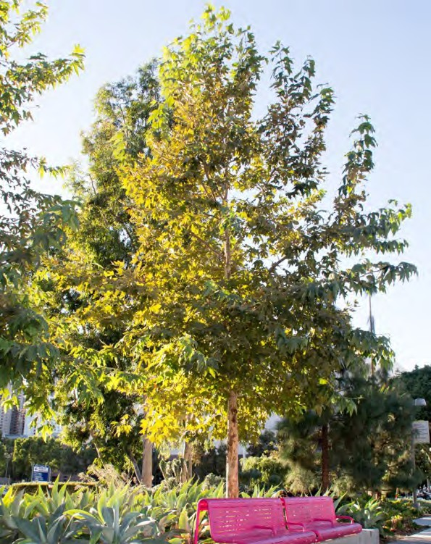
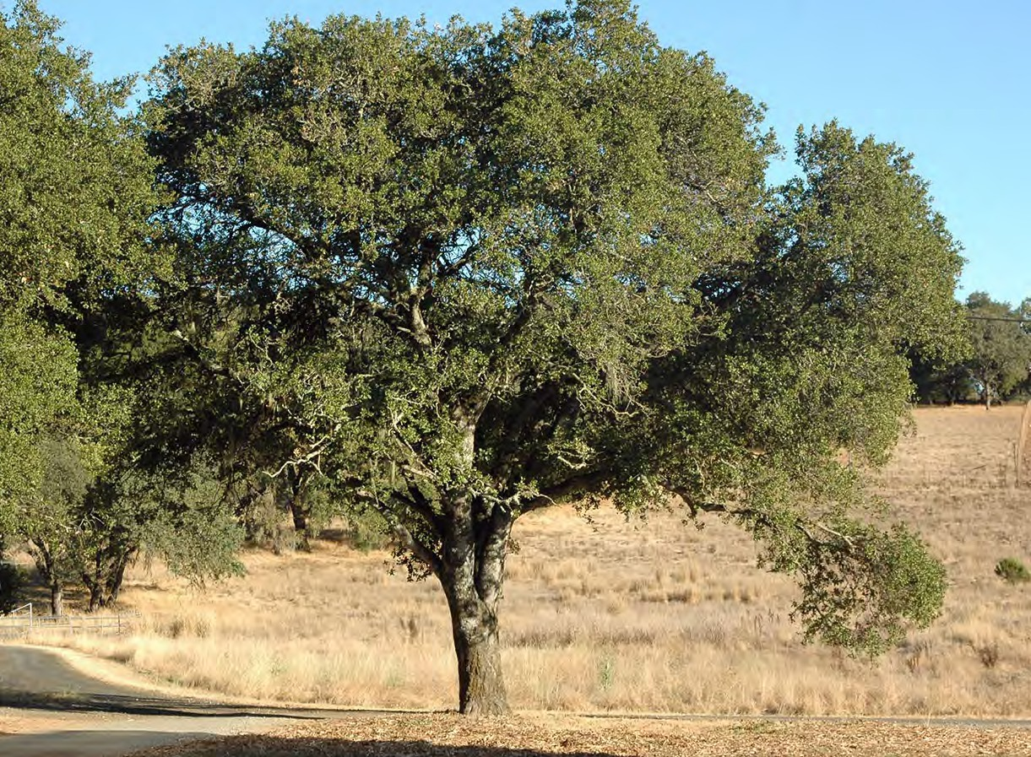
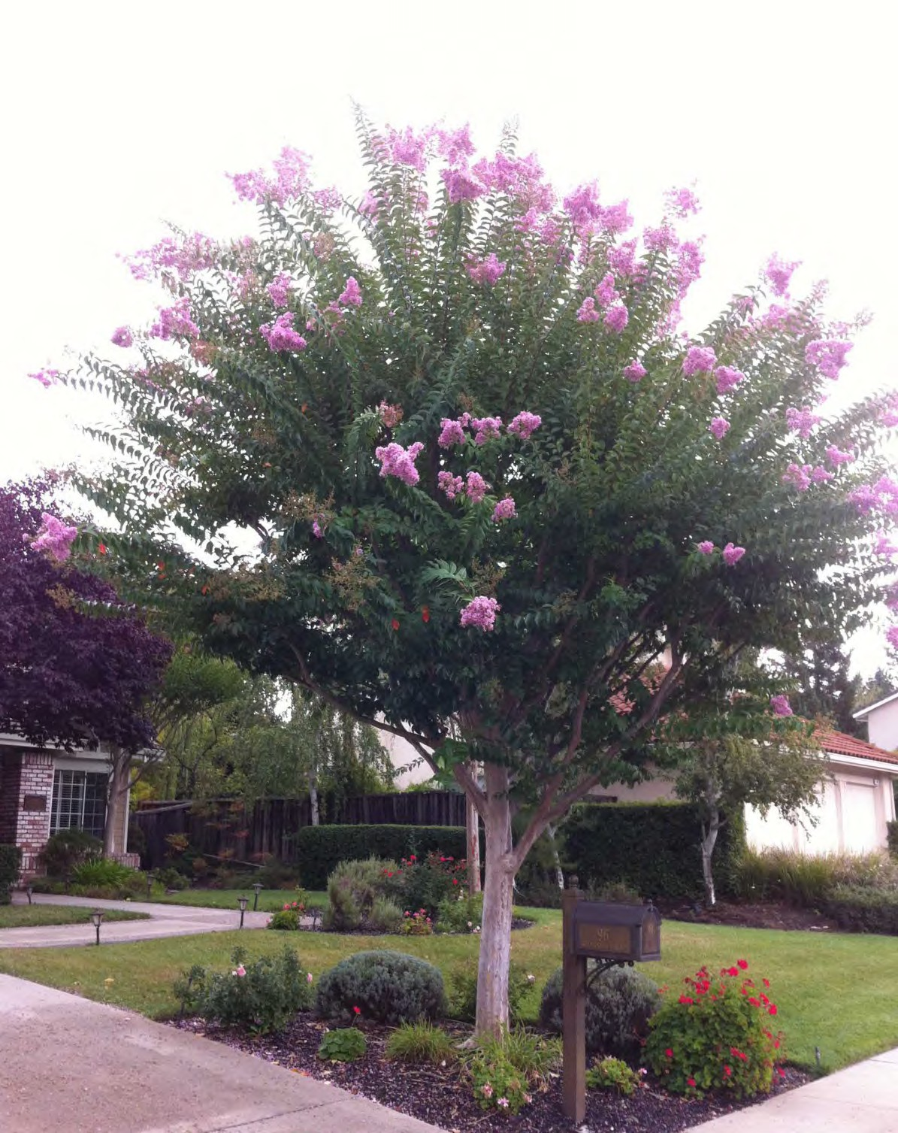
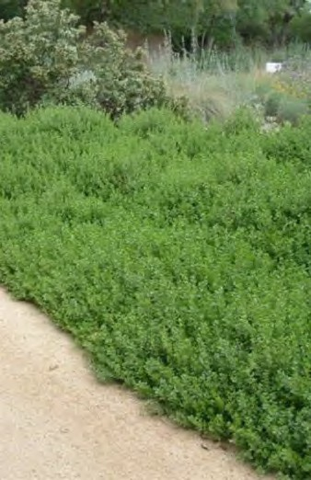
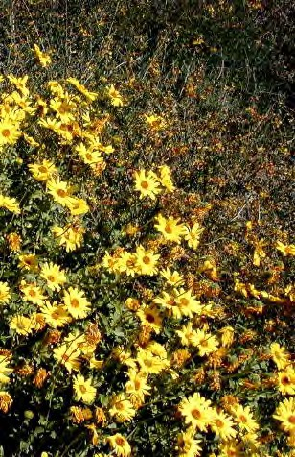
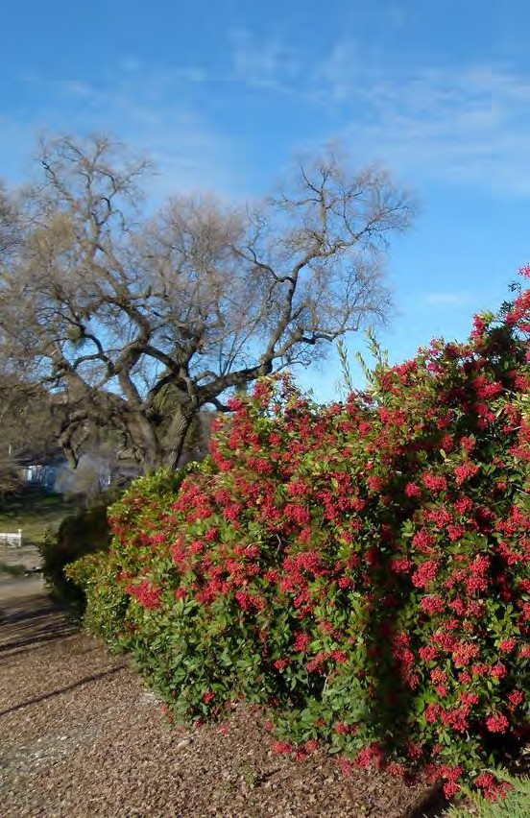
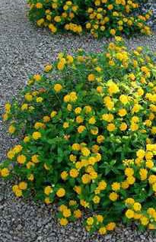
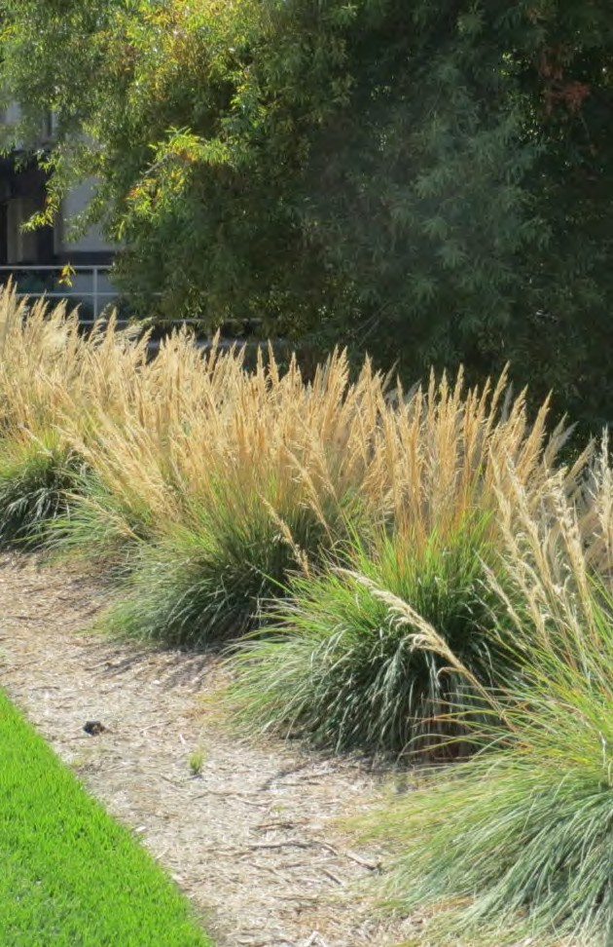
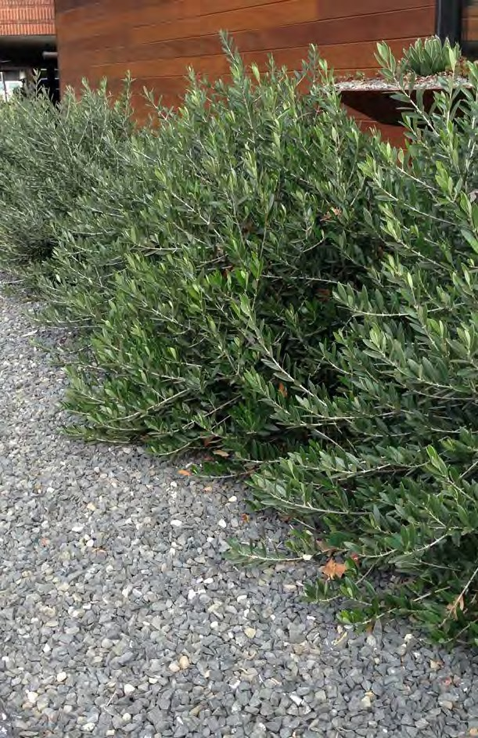
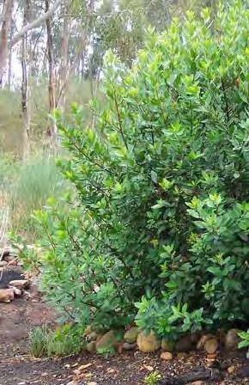
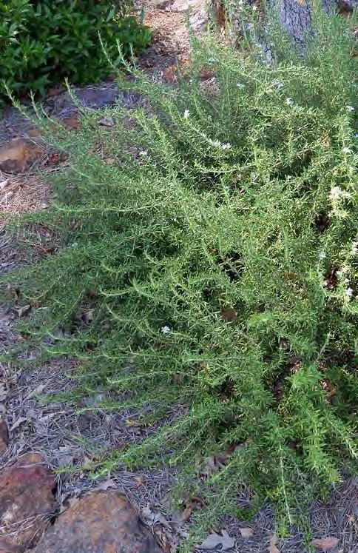
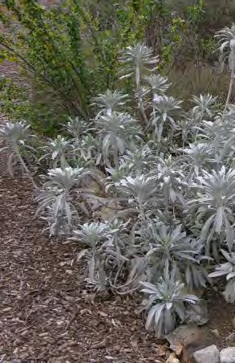
JORDA N
A R C H I T E C T S
131 CALLE IGLESIA, SUITE 100 SAN CLEMENTE, CA 92672
LAGERSTROEMIA INDICA X FAURIEI 'MUSKOGEE' / MUSKOGEE CRAPE MYRTLE
TREES
PLATANUS RACEMOSA / WESTERN SYCAMORE
QUERCUS AGRIFOLIA / COAST LIVE OAK
A
N
D
S
C
A
P
D
L
B
E
A
E
B
E
R
R
E
S
T
L
C
S
I
A
H
N
V
4
I
E
A
6
T
R
2
E
C
T
4
C
I
Signature
Renewal Date Date
T
L
S
A
T
I
A
N
T
R
E
O
C
F
O
I
L
F
A
BACCHARIS P. 'TWIN PEAKS' / DWARF COYOTE BRUSH
ENCELIA CALIFORNICA / CALIFORNIA BRITTLEBUSH
LANTANA 'NEW GOLD' / NEW GOLD LANTANA
MUHLENBERGIA RIGENS / DEER GRASS
HETEROMELES ARBUTIFOLIA / TOYON
FALLBROOK SELF STORAGE
1305 E. MISSION ROAD FALLBROOK, CA 92028
OLEA MONTRA / LITTLE OLIIE
SHRUBS
ROSMARINUS O. 'PROSTRATUS' / PROSTRATE ROSEMARY
SALVIA APIANA 'COMPACTA' / WHITE SAGE
Date: 09-02-25
Project: FALLBROOK SELF STORAGE
File: Revisions:
RHUS INTEGRIFOLIA / LAUREL SUMAC
Sheet Title:
PLANTING
IMAGERY
Sheet Number:
L3.1

